Slide 1
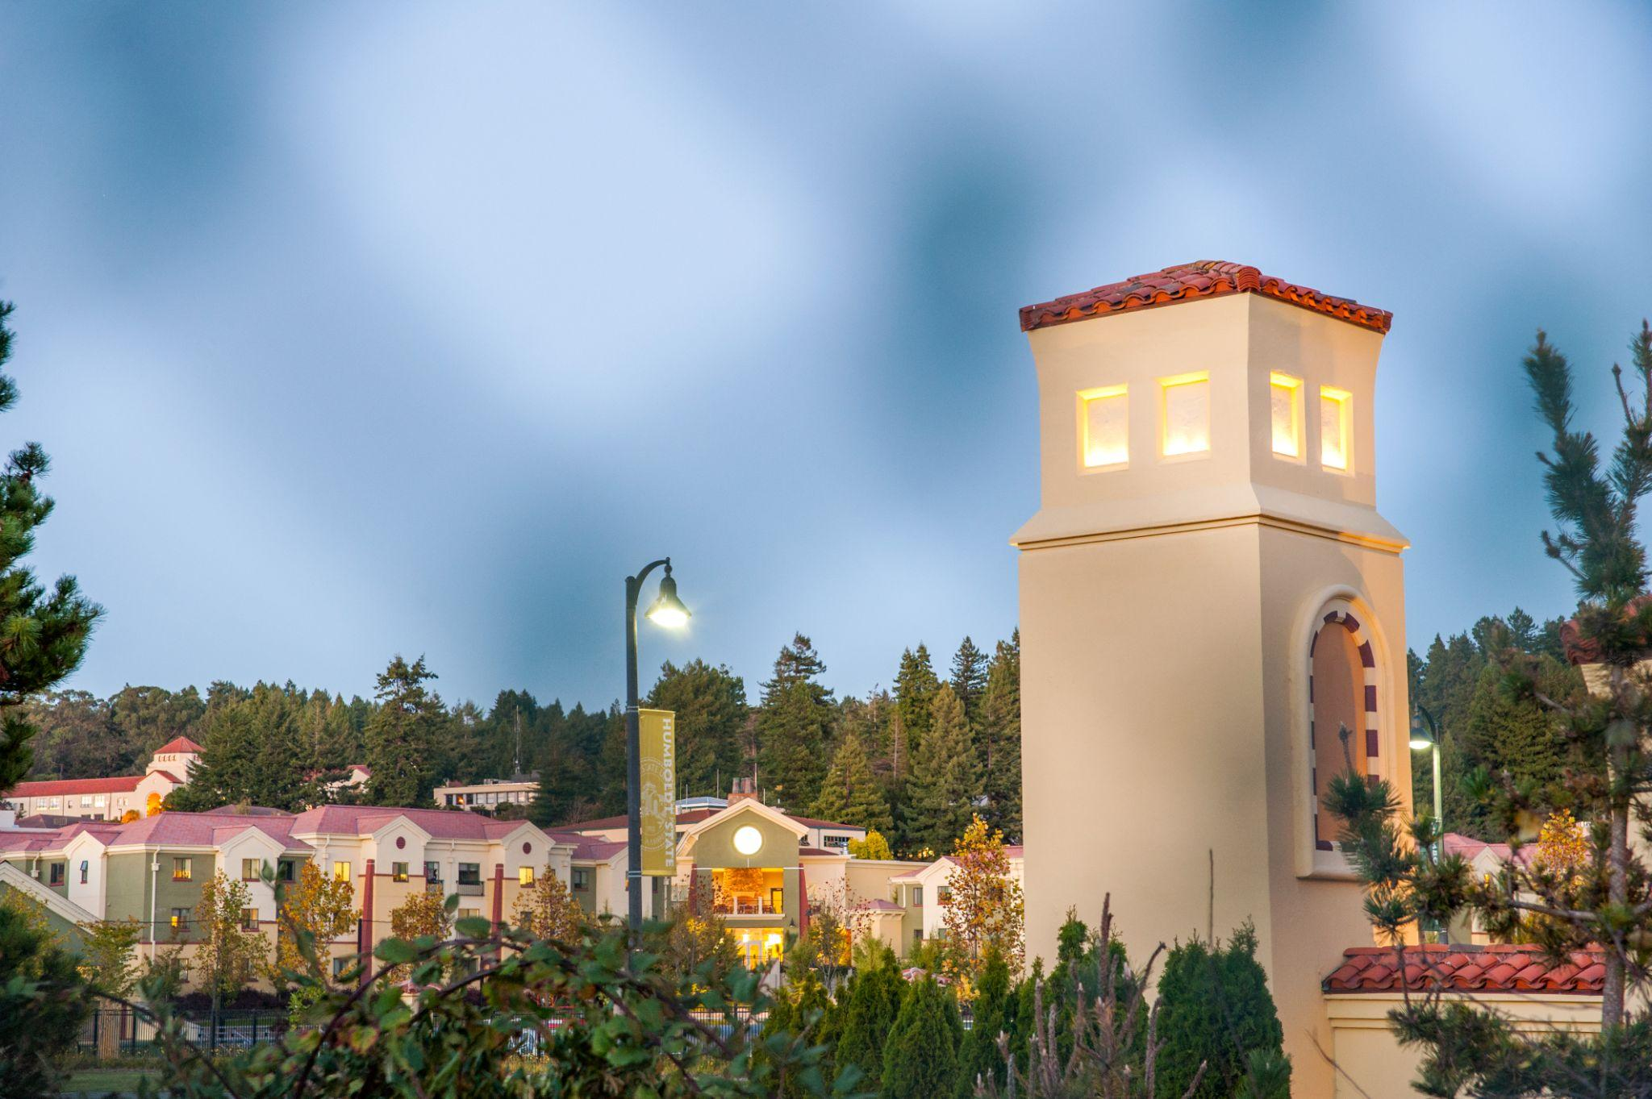
INFORMATION SESSION | FALL 2023 | DECEMBER 14, 2023 | 1:30 P.M. - 2:50 P.M.
California State University
Chancellor's Doctoral Incentive Program (The CDIP Fellowship)

Slide 2
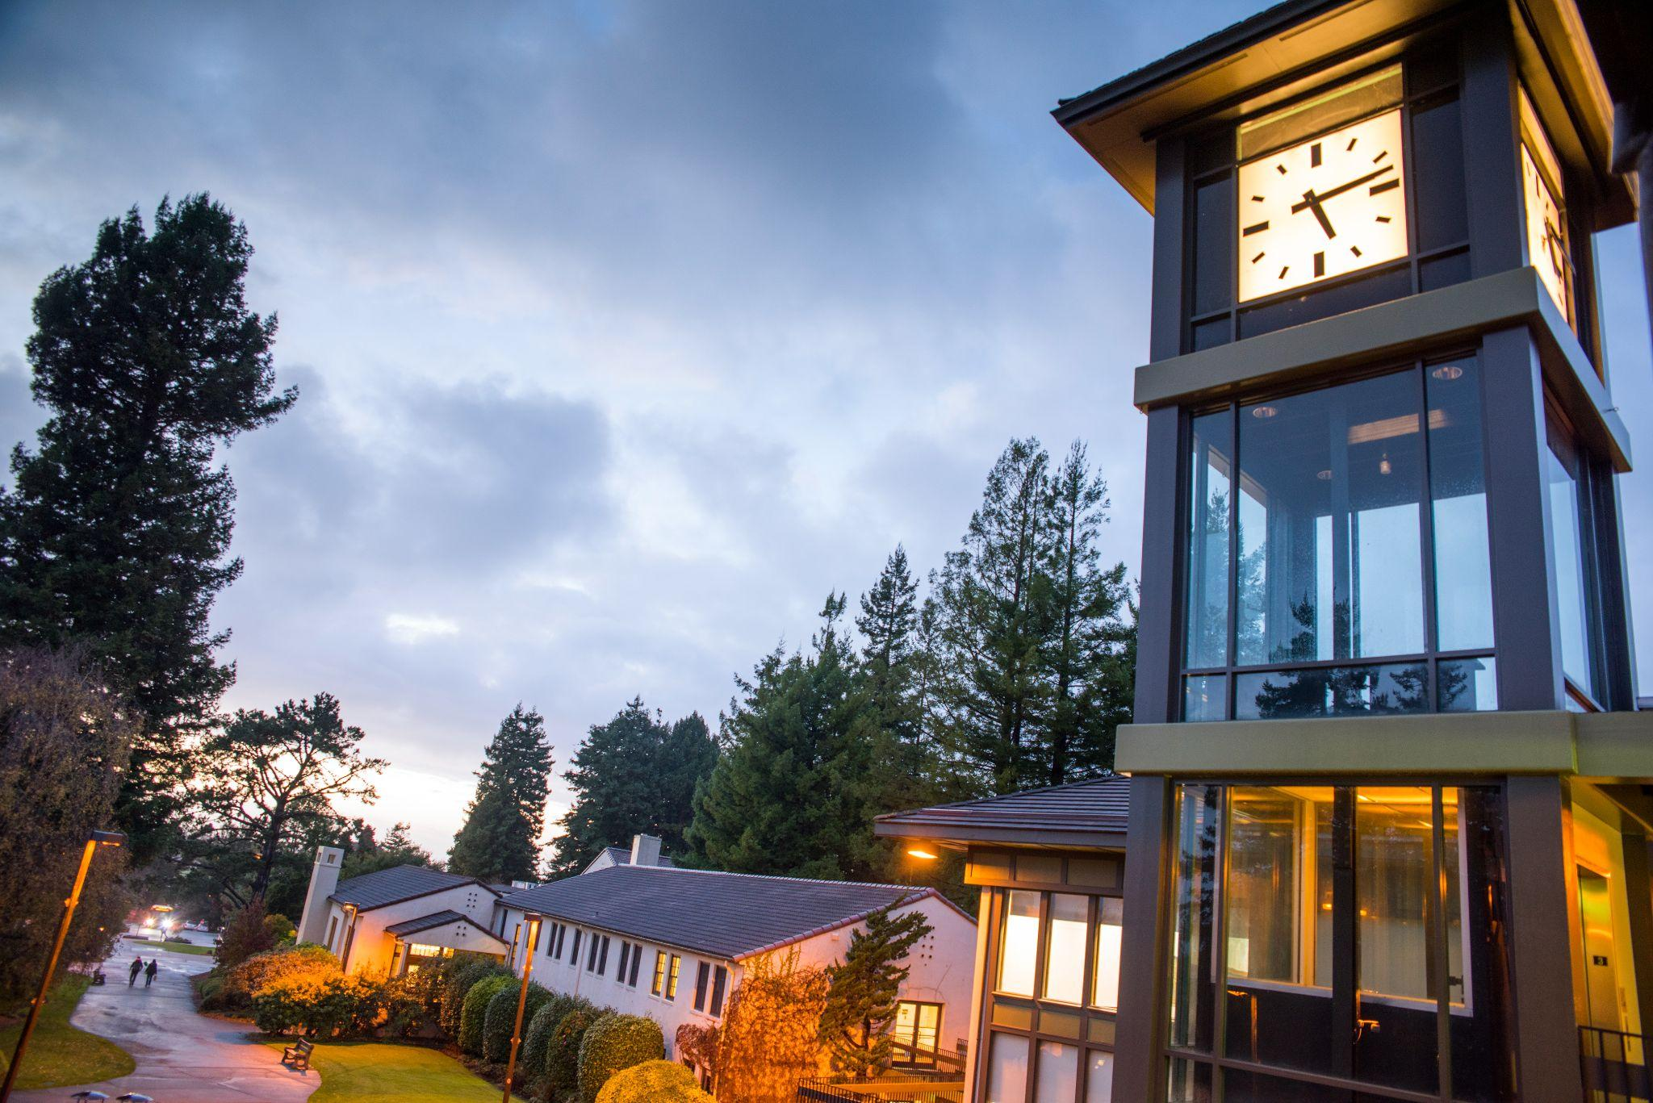
About CDIP
Goal
increase number of faculty with qualifications, motivation, and skills to teach the diverse students of the CSU
Prepares doctoral students for CSU faculty positions
provides financial support, mentorship by CSU faculty and professional development and grant resources
More information? Contact Campus Coordinator at Cal Poly Humboldt
Terri Fisher, Graduate Studies Specialist
terri.fisher@humboldt.edu
www.calstate.edu/csu-system/faculty-staff/cdip

Slide 3
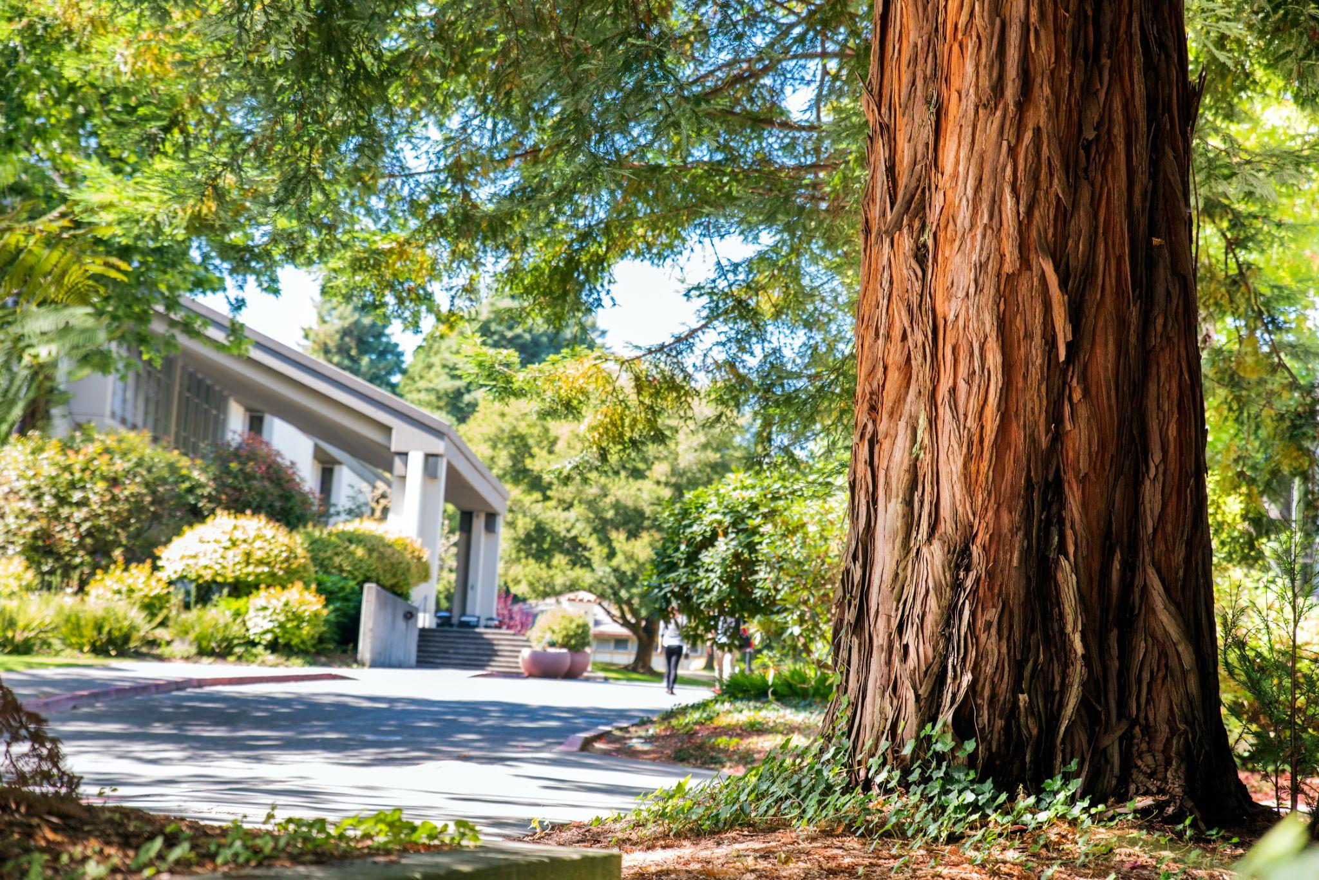
CDIP benefits
Faculty Mentorship
activities to build your academic portfolio in teaching, research, and service
builds on a tradition of mentorship for early career scholars
Professional Development & Grants
Mini-Grant Program: opportunities to conduct research: $2,500
Travel Grant Program: to present your work at conferences: $1,500
Dissertation Fellowship: $5,000
Subsidized Educational Loan
Up to $30,000 with a potential for cancellation

Slide 4
CDIP Application
Curriculum Vitae (CV)
Faculty Mentor
Tenured/Tenure-Track CSU Faculty Member
CDIP: Collaborative Plan of Support (outline activities with faculty mentor)
Qualification & Motivation Statement (3 pages)
Letters of Recommendation
All applicants: One letter from your proposed CSU Faculty Mentor
Doctoral students: a second letter from faculty in their doctoral program
Undergraduate/Master's level students: request a second letter from someone who can address your qualifications for CDIP

Slide 5
Apply to CDIP: MArch 1, 2024
Online application due:
March 1st, 2024
Prepare all the information needed to apply ahead of time
Application must be submitted in one sitting
You cannot save the application in progress
A copy of the application can be sent to you after you successfully complete it

Slide 6
Iván’s
Sample materials

Slide 7
Collaborative Plan of Support: Prepare with your faculty mentor
Examples and templates available on CDIP website
Available here or contact Iván for sample or support

Slide 8
THREE TIPS ON WRITING
FELLOWSHIP APPLICATIONS

Slide 9
THREE TIPS ON WRITING FELLOWSHIP APPLICATIONS
1) Process, not outcome
Focus on the process not the outcome of your application
Chances of winning are low, but…
Process of writing and figuring out who you are as a scholar is priceless
Bonus: You'll recycle language for future applications
Also: Start with small internal fellowships/grants. These successful application demonstrate potential for larger/national competitions

Slide 10
THREE TIPS ON WRITING FELLOWSHIP APPLICATIONS
2) Be vulnerable, yet proud
Write personal statements that make you feel slightly vulnerable & proud at the same time
Tell your unique story. No one else has your unique perspective
Bonus points: if you get misty eyed re-reading it to yourself years later

Slide 11
THREE TIPS ON WRITING FELLOWSHIP APPLICATIONS
3) Peer edit & Share early drafts
Sharing a rough draft is scary but super helpful!
Don’t wait until you have a fully-formed and polished application
Helps you workshop ideas and applications in their early stages
Create spreadsheet of annual applications & prepare for next year

Slide 12
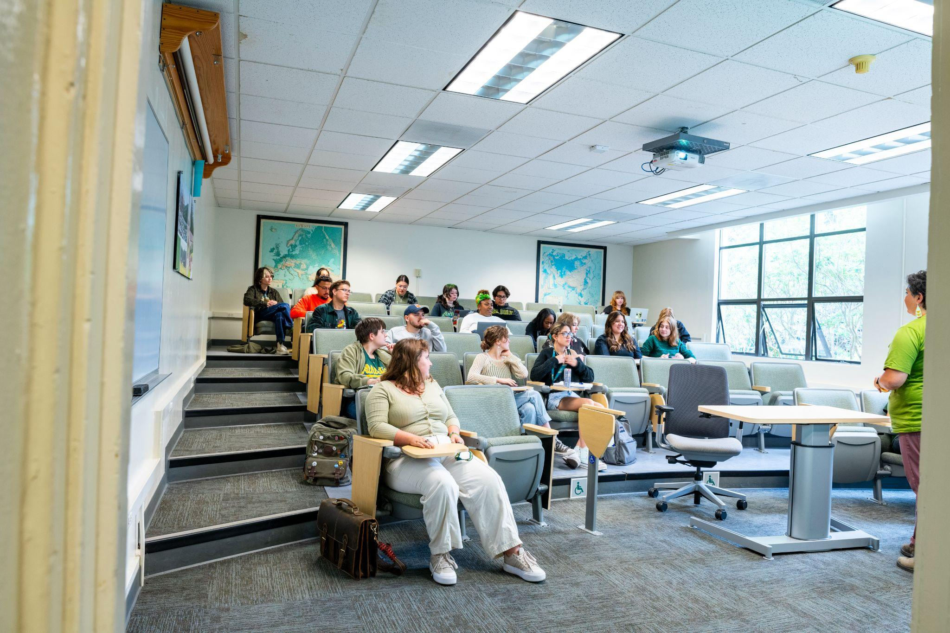
Questions?
Iván González-Soto
2023-2024 CSU CDIP Fellow
@ Cal Poly Humboldt
Department of Environmental Studies
igs38@humboldt.edu
www.ivan-g-soto.com

