Slide 1
The Chancellor’s Doctoral Incentive Program
Developing Future Faculty

Slide 2
History
Recruiting faculty as diverse as our students
•Formed in 1987 by three CSU President’s
•Funded by Lottery Funds
•Supported over 2,400 doctoral student’s nation-wide
•Available to CSU and non-CSU students

Slide 3
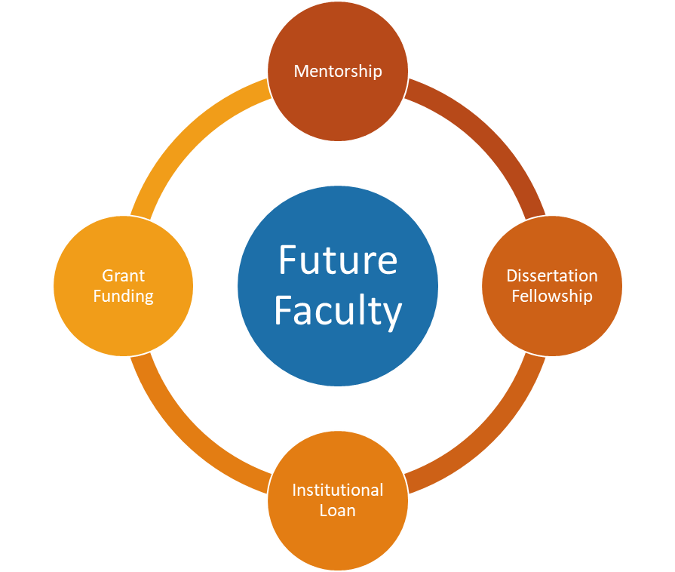
What CDIP Offers
Mentorship by a CSU Faculty Mentor
•Supports professional development in teaching, research and service activities while in graduate school
•Provides advice and guidance to help enhance potential for employment in a CSU tenure-track faculty position
Grant Funding
•Two types of grants available to students to conduct research and/or travel to conferences
•Membership for to the National Center for Faculty Development & Diversity (NCFDD)
Dissertation Fellowship
•Supports doctoral completion in the final year of dissertation
•Ten fellowships available in the amount of $5,000
Institutional Loan
•Loans up to $10,000 per year with a maximum amount of $30,000 over the duration of their doctoral study

Slide 4
Eligibility
Full-time doctoral students enrolled in an accredited program in the U.S. or undergraduate and master’s level students applying to an accredited doctoral program in the U.S.
Must have a strong desire to teach the diverse student body at the CSU
Applicant does not have to be a CSU student, but must have a CSU faculty mentor

Slide 5
Quick Stats
64% of CDIP fellows have successfully earned their doctoral degree
Over $820,000 has been awarded since 2010 to fellows for professional development
33% are enrolled in UC doctoral programs
The 2020 Cohort Identified as:
66% are female
62% are doctoral students of color

Slide 6
The Application Process
Contact a CDIP Coordinator at one of the campuses
Gather the five application components
CV
Motivation Statement
Collaborative Plan of Support
CSU Faculty Position Announcement
Two Letters of Recommendation
Submit the application by February 3, 2023

Slide 7
Ready to Learn More?
Visit our website: www.calstate.edu/cdip
Contact us:
Campus Contact

